Slide 1
Finding best places to Dine In New Delhi
Alisha Kapoor
December 13, 2020

Slide 2
New Delhi is a big city and new restaurants open up everyday.
It hosts a population of 1.9 crores.
When it comes to food, there are thousands of options as well.
The city is crowded with a lot of restaurants and fine places to dine in. It becomes tricky to find restaurants that offer customer satisfaction,
And doesn’t create a hole in your packet.

Slide 3
Data acquisition and cleaning
Sources of Data
Foursquare API to select the number of restaurants and their locations in New Delhi.
b) Zomato API to fetch ratings and average price of the restaurants using my developer credentials.
I have first created a dataset thought the Foursquare API to explore several types of venues, such as ID, name, latitude, longitude, neighborhood, and distance (in meters) to Connaught place which is a hub for restaurants in Delhi.
And then I have used Zomato API to fetch price for two and ratings of the restaurants. My main intent for using Zomato API is to fetch the average price and ratings.

Slide 4
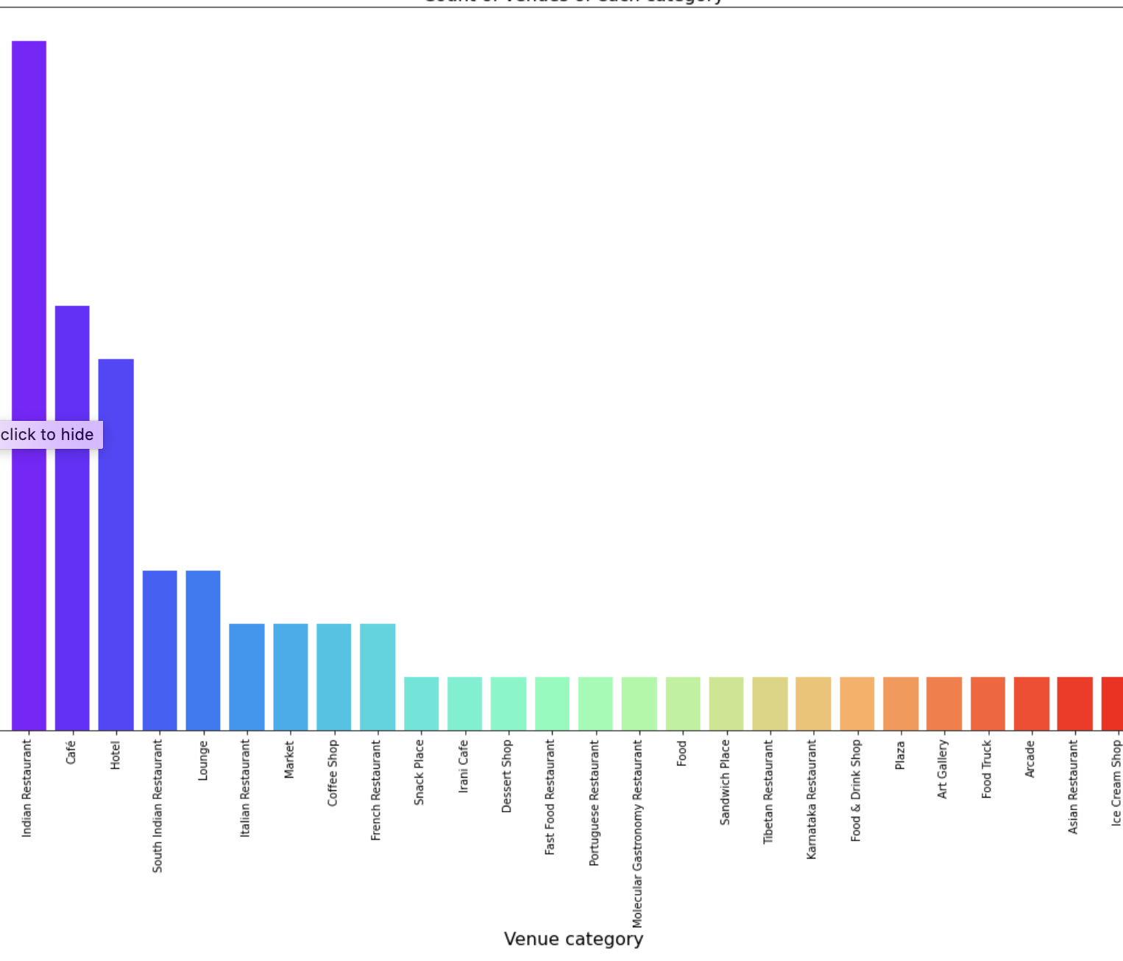
Exploratory Data Analysis
Data is plotted on the map to figure out the type of restaurants available.
From the plot it is clear that maximum number fo restaurants are:
Indian Restaurants
Cafes
Caption

Slide 5
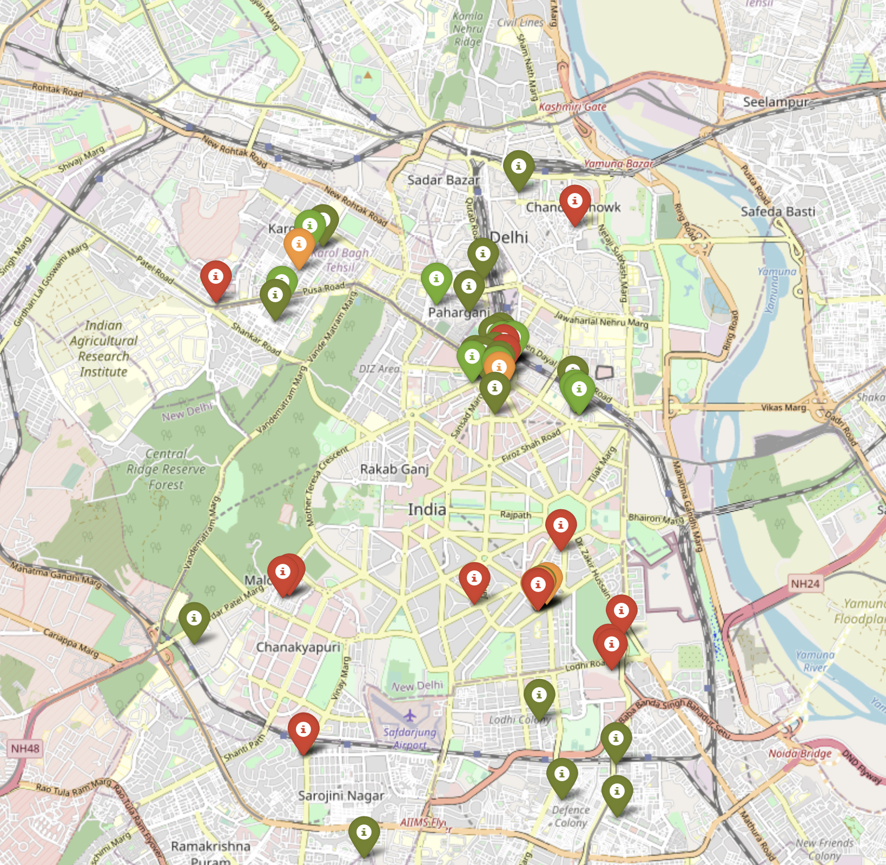
Plotting the restaurants on Map on the basis of price range
-Green means the restaurants are the cheapest.
-Red indicates restaurants are the most expensive.
Caption

Slide 6
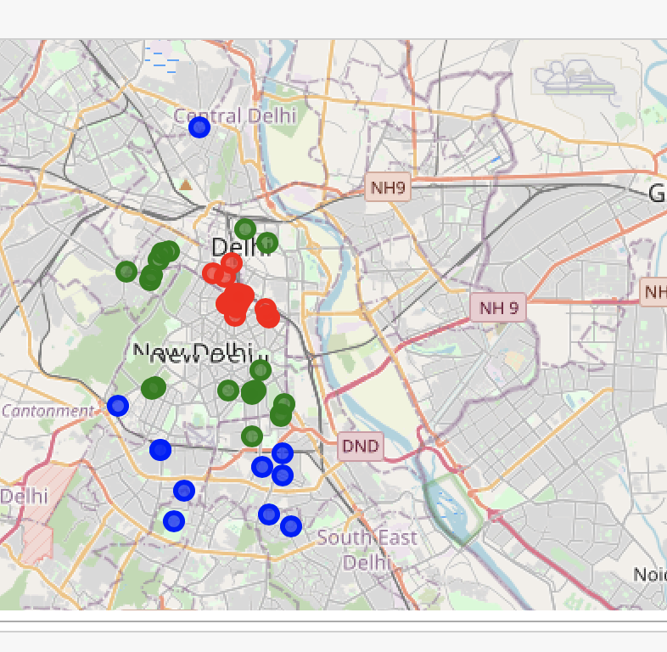
Modellling
I applied classification model to cluster the restaurants into three different clusters indicated by three different colors:
Cluster ‘0’ is marked with colour green.
Cluster ‘1’ is marked with colour red.
Cluster ‘2’ is marked with colour blue.
Caption

Slide 7
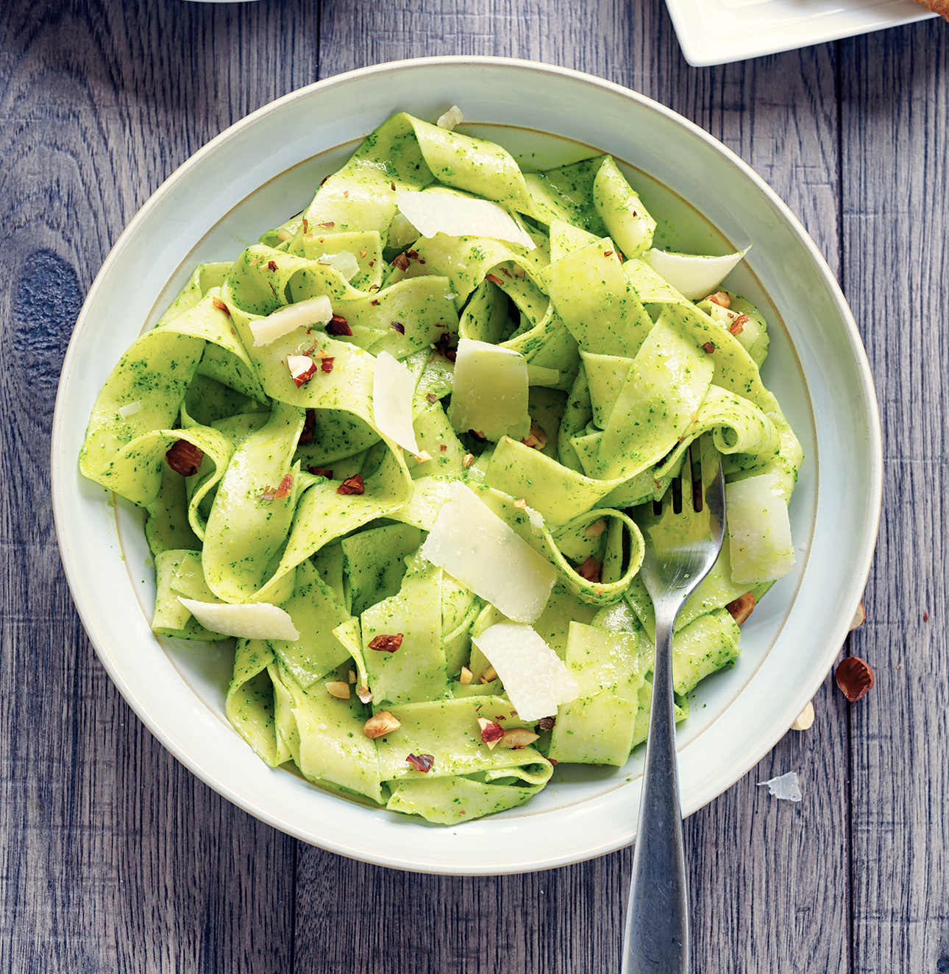
Conclusions
We saw that most of the restaurants in Delhi are Indian restaurants and cafe.
We also saw that restaurants have different pricing range but majority of the restaurants have Lower price range.
Finally, through clusters we identified that there are many venues which are relatively lower priced but have an average rating of 3.75
On the other hand, there are few venues which are high priced and have average rating of 4.10.
If you're looking for the best places, with the highest rating but might also carry a high price tag, you should visit restaurants marked by cluster 0.
If you are looking for good restaurants which are not very expensive but have fairly good rating, visit the restaurants marked by cluster 1.
If you're looking for cheap places with relatively high rating, you should check restaurants marked by cluster 2.

